Slide 1
Assessing sampling methods for generalization from RCTs: Modeling recruitment and participation
Gleb Furman and James E. Pustejovsky
University of Texas at Austin

Slide 2
Background
Large-scale effectiveness trial
Multi-site RCT
Nationally representative sample
60 schools
Stratified Balanced Sampling (SBS; Tipton, 2013)
Stratify population using cluster analysis
Sample proportionately from each stratum
Prioritize schools most “like” the stratum
Replace refusals with next best school
Notes:
The impetus for this project came from my work on a large-scale effectiveness trial. I was asked by the PI to help implement a sampling design which would result in a nationally representative sample of 60 schools. The idea was to make inferences about the treatment effect in the population of schools in the US, with some restrictions.
The design we settled on was one proposed by Tipton, which we are dubbing Stratified Balanced Sampling (SBS). I’ll get into more detail later but the general idea is
1. Stratify the population along a set of covariates related to treatment effect heterogeneity
2. Sample from each stratum proportionally
3. Prioritize schools that are most like their stratum for recruitment
4. As schools refuse to participate, take note of why and move on to the next best school
This method was appealing because we felt it was flexible and didn’t require us to know ahead of time which schools, districts, or States we had access to for recruitment. This was particularly useful because this would be a three year study, with a cohort of about 20 schools recruited every year.,

Slide 3
Technical Difficulties
Recruiting is hard
“High priority” schools didn’t always cluster
No relationships in districts/states
Cold-calling wasn’t very effective
Stratified convenience sampling is easier
Was what we were doing effective?
How would it compare to convenience sampling?
Is the full implementation of SBS even possible?
Notes:
It quickly became apparent after the first couple of meetings with the recruitment team that my statistical ideals had no place in the cold hard reality of middle school recruitment. It turns out recruitment is hard. High priority schools wouldn’t always be clustered together. So the top 5 schools from a stratum might all be in 5 different States, which was impractical for logistical reasons. Or when they clustered we would have no relationships in the schools or districts. This was a problem because it turns out cold-calling isn’t highly effective.
This was really unfortunate because the recruitment team had a really high level of buy in with the method, which is another advantage of SBS. They really understood it and understood why it would be effective. They saw value in it. But more than that they saw the value in recruiting 60 schools for a study that was powered for 60 schools. Because if we weren’t powered to detect a treatment effect this was no good for anyone. So our sampling design morphed into this stratified convenience sample hybrid.
And this begged several questions. So I took my statistical ideals to where they could actually be realized, a simulation.

Slide 4
Effectiveness vs Feasibility
Effectiveness
How generalizable is the sample?
Subset of external validity
Can we extrapolate the estimated average treatment effect (ATE) to units or sites outside of the sample?
Feasibility
How much “effort” does it take to implement a sampling method
Notes:
And so there was this tension between effectiveness and feasibility. Effectiveness refers to the ability to recruit a representative sample so that we can generalize the treatment effect beyond the sample. That’s our focus here: the subset of external validity that allows us to extrapolate treatment effects beyond the sample to some population.
At the same time a method that resulted in a highly representative sample was no good to anyone if it couldn’t be implemented. So feasibility is really important as well. We already have a sampling method for this, probability sampling. Even a simple random sample should on average net you a representative sample (of schools that are willing to participate).
But very few implant SRS at this scale because it’s costly.

Slide 5
Simulation Design
Population frame
9882 Elementary schools
6 states (CA, OR, PA, SC, TX, WI)
Context
Large scale multi-site RCT
Select representative sample of 60 schools
Sampling methods
Stratified Balanced Sampling (SBS)
Unstratified and Stratified Convenience Sampling (UCS, SCS)
Unstratified and Stratified Random Sampling (URS, SRS)
Notes:
So we set out to design a simulation study. We wanted to make it reasonably realistic, so we used real data to serve as our population frame. This covered approximately 10,000 elementary schools from 6 states.
We wanted to mimic recruitment for a large-scale multi-site RCT, where the goal was to select a sample of 60 schools which would represent the population
And finally we wanted to compare several sampling methods.

Slide 6

Participation Model
Participation propensity score ($π_{i}^{p}$)
$$log\left(\frac{π_{i}^{p}}{1−π_{i}^{p}}\right)=X_{i}β$$
Notes:
One of our biggest challenges early on was to figure out how we would generate participation behavior. Schools and districts, of course, have the option of refusing to participate in RCTs, which they use liberally. But we weren’t sure what drives refusal or how to model that.
We settled on generating a “participation propensity score” using a simple linear transformation of covariates with a logit link. This represents the probability that a site would participate in our hypothetical trial if we approached them for recruitment.
Luckily not too long before we got started on this there was some work that examined the differences between the types of schools that participated in RCTs and the overall population. We used this study to inform the covariates in the participation model.

Slide 7
Participation Model
Covariates
School locale indicators
Urban
Suburban
Town/Rural (ToRu)
Student demographics
% English language learners (ELL)
% economically disadvantaged students (ED)
% students identified as minority (Min)
Student academic achievement
% of students proficient or better in Math
% of students proficient or better in ELA

Slide 8
Parameters were selected to mimic sample characteristics reported by Fellers (2017)
Par
Notes:
We then iterated across values of coefficients until our sample on average differed from our population in similar ways that were reported in the study.
The other unknown was what the overall participation rate in the population should be. So on average, what proportion of the population of schools is willing to participate in an RCT.

Slide 9
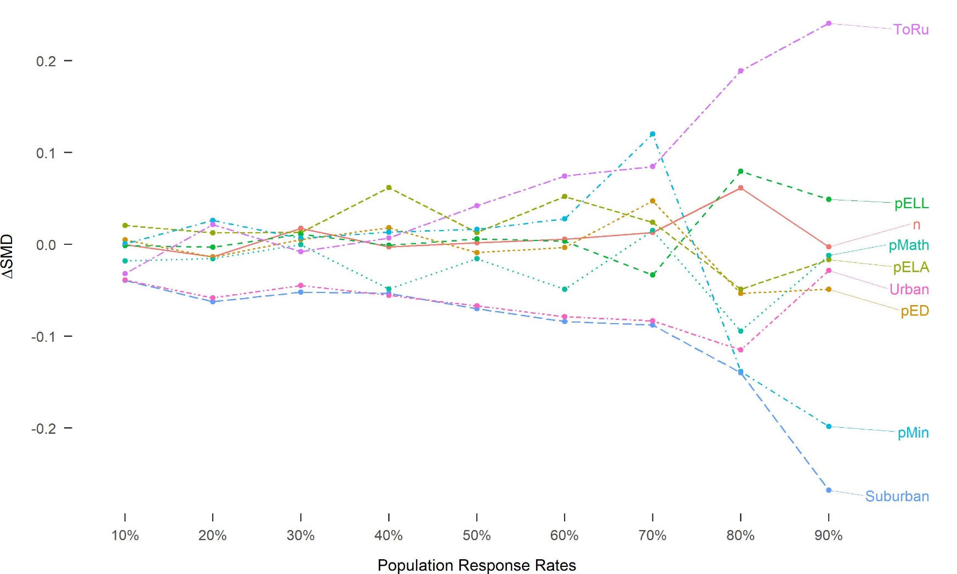

Slide 10
Sampling Designs
SBS

